Slide 1
Custom Vision Service
How it works?

Slide 2
Optimization Levels in Machine Learning
All machine learning modeling can be broken down into three phases.
Exploring Hypothesis Space (Model Selection): always designed manually.
Tuning Hyperparameters: enabled by computational packages but mostly designed manually.
Training Model Parameters: always handled by computational packages.

Slide 3
Customvision
Since the customvision does not require the user to select the model and model hyperparameters, it automates all three levels of optimization.
Customvision documentation does not exactly reveal how it searches among top two levels of optimization that we defined. But the documentation states that it uses techniques such as Transfer Learning and Image Augmentation.
Now we will try to understand what these techniques are.
customvision documentation

Slide 4
Transfer Learning
To build prior knowledge into the development of the model so it does not learn solely from the data of the problem at hand. Two common ways this is done is through a concept called transfer learning in computer vision and domain adaptation mainly through the use of word embeddings in natural language processing.
Transfer learning enables data scientists to quickly adapt existing pretrained models (e.g., AlexNet, ResNet-50, InceptionV3, etc.) to new domains.

Slide 5
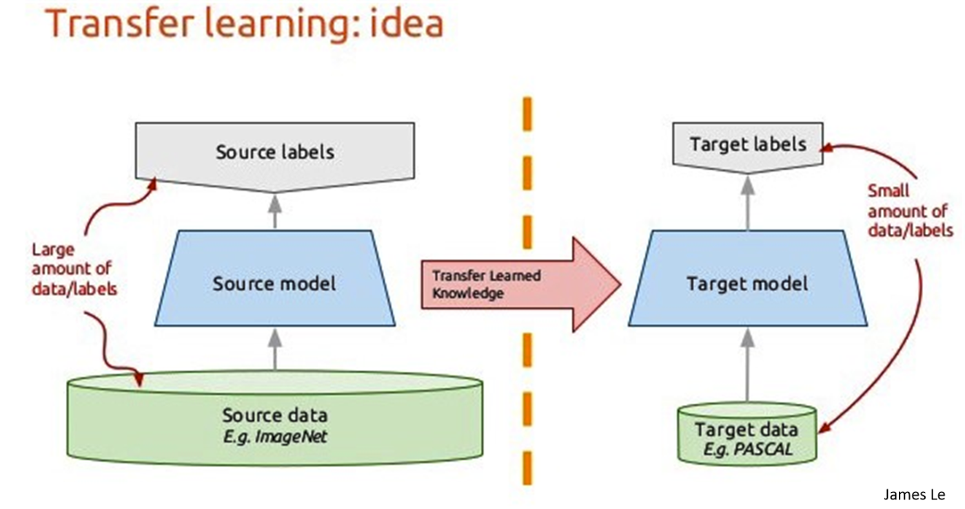

Slide 6
Two conceptual parts of CNN
CNNs can be conceptually split into two main pieces, both of which are optimized together:
1. The automatic feature extractor creates the hidden feature state—features that represent aspects of image that are relevant for classification—and is made up of layers such as convolutional and pooling layers.
2. The classifier is a fully connected neural network made up of at least one layer that classifies the hidden feature state.

Slide 7
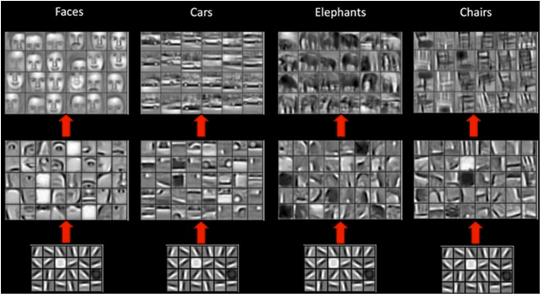
Visualizing increasingly complex filters learned in CNN layers.

Slide 8
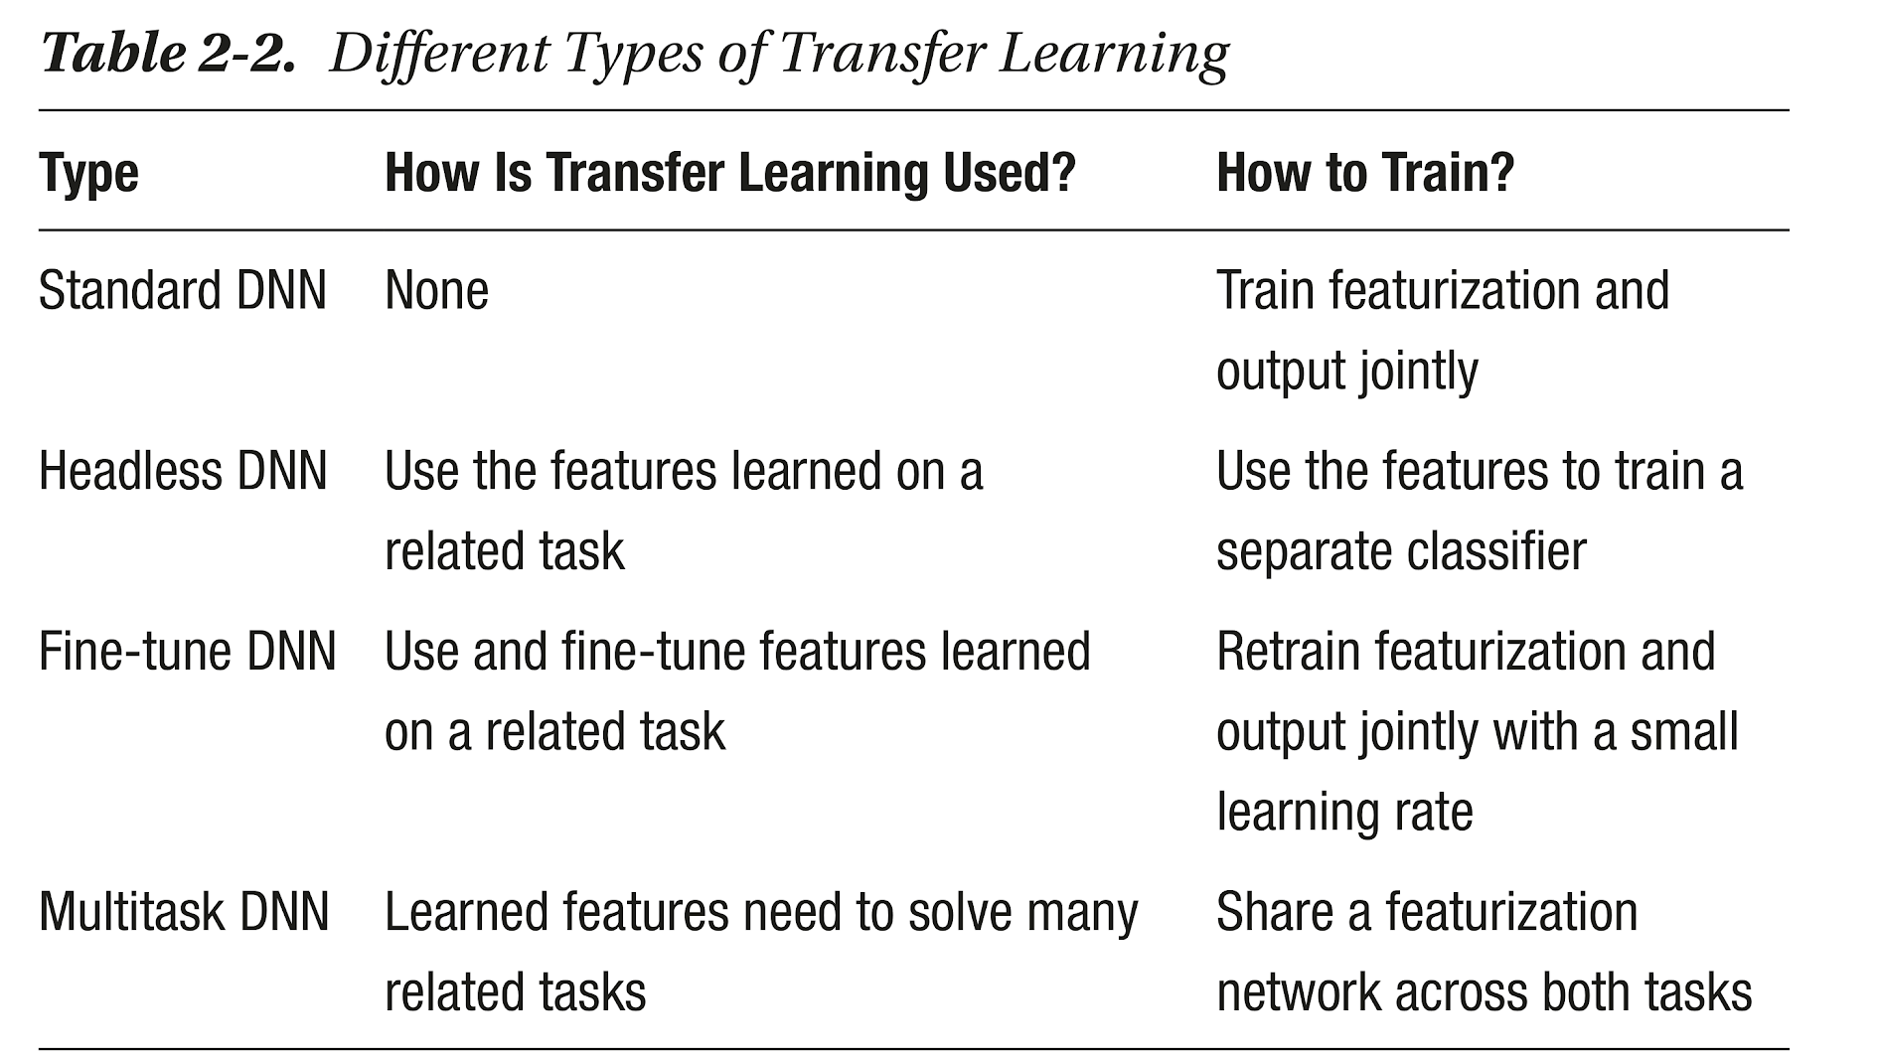

Slide 9
Pre-trained Model Approach
Select Source Model. A pre-trained source model is chosen from available models. Many research institutions release models on large and challenging datasets that may be included in the pool of candidate models from which to choose from.
Reuse Model. The model pre-trained model can then be used as the starting point for a model on the second task of interest. This may involve using all or parts of the model, depending on the modeling technique used.
Tune Model. Optionally, the model may need to be adapted or refined on the input-output pair data available for the task of interest.
Read more here

Slide 10
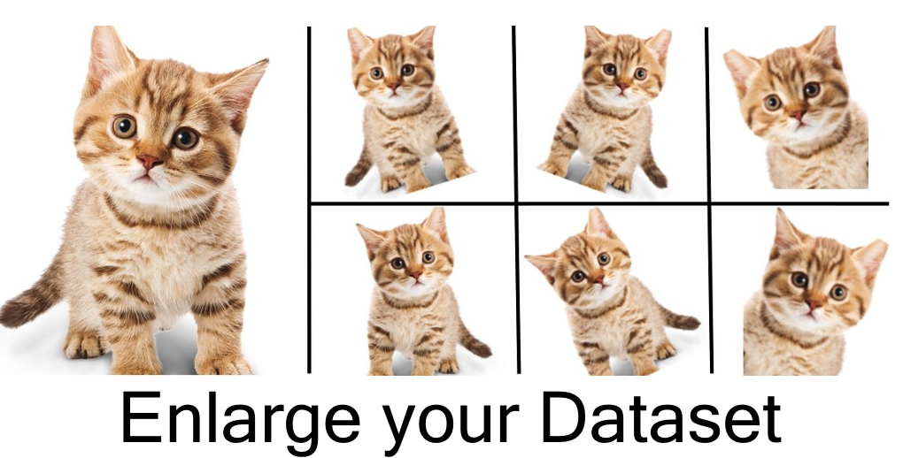
Image Augmentation and translation Invariance
Translation invariance is a concept that an object should be detected irrespective of its location and orientation. So dataset can be enhanced by creating new images by transformations of the existing images. Read More

Slide 11
Custom Vision Training
So based on these ideas that is what I suppose happens when you Train a model.
Image Augmentation
Selects a suitable trained CNN based on domain you choose
Initializes parameters for feature extraction layers
Trains fully connected Layers (and might fine tuned inner layers)

Slide 12
Benefits and Drawbacks
Small Training Data (50 to 100 for a classifier)
Faster Training
Model might not be globally optimum in all three levels of optimization.

Slide 13
Data Centric Model Improvement
Since everything else is taken care of, the only thing that the model developer needs to worry about is the quality, diversity and quantity of data provided to the model. Following are important considerations in data preparation.
Class Imbalance Treatment (read more)
Ensuring variation in light condition, background, angles, styles
Ensuring that non characteristic features are uniformly distributed among label classes. (So that model does not associate e.g daylight with a certain class)

Slide 14
A valuable resource
Book: Deep Learning with Azure
I have the pdf copy of this book, you can reach out to me if you want it.

